Slide 1
Javascript Loops
By Audrey Spjut

Slide 2
Description
Javascript can execute blocks of code in loops.
Loops executes a function a certain number of times until a certain amount of times until the code has been fulfilled
Can be helpful with Arrays (multiples values in a variable)

Slide 3
Types of Loops
“For”
“For - in”
“While”
“Do - while”
Notes:
Four different types of loops: FOR, FOR - IN, WHILE, DO - WHILE. Go over them in next slides

Slide 4
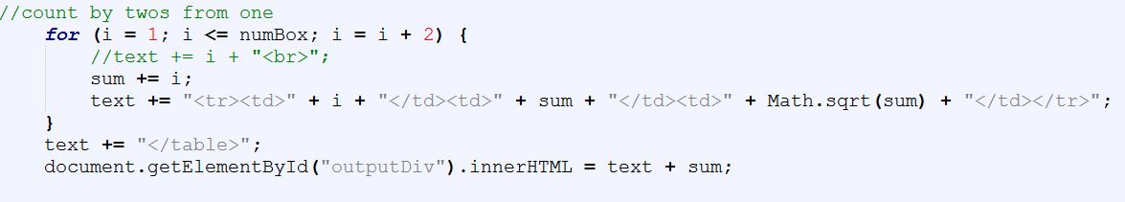
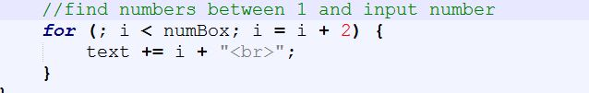
For Loops
Syntax: for (statement 1 (initialize); 2 (test); 3(Increment or decrement) {executed code};
Useful for basic loops
Notes:
Syntax has three different statments - initialize, test, and the increment or decrement. Sometimes you don’t have to include the initialize if you declare it before the loop. This first loop should show odd numbers, the second should do the same (IMGS used here are my own)

Slide 5
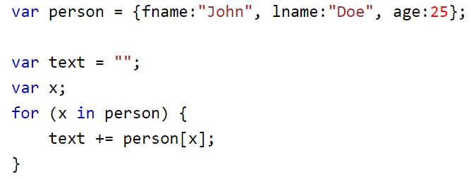
For In Loops
Syntax: for (var in var){executed code};
Useful for looping through properties of an object
Notes:
In this loop it should display “John Doe 25” (IMGS here are w3schools)

Slide 6
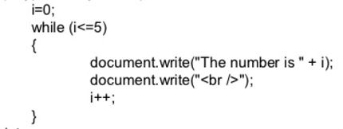
While Loops
Syntax: while (condition) {executed code; (increment here);}
(declare var i before)
Useful for incrementing in code instead of in statements
Notes:
In while loops you’ll use your condition in the beginning and declare your variable (i) and increment in different areas (var before and increment/decrement in executed code) IMG source from geetanjali http://ex.mwanwan.co/t/A5oalax8

Slide 7
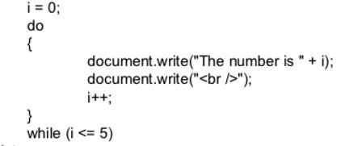
Do While Loops
Syntax: do {executed code; (Increment here);} while (condition);
Useful for looping text while a certain condition is made available (usually from user input)
Notes:
Again assign var before loop. Also increment/decrement between curly braces. IMG source geetanjali http://ex.mwanwan.co/t/A5oalax8

Slide 8
Sources
http://w3schools.com
http://codecademy.com
Geetanjali http://ex.mwanwan.co/t/A5oalax8

